Slide 1




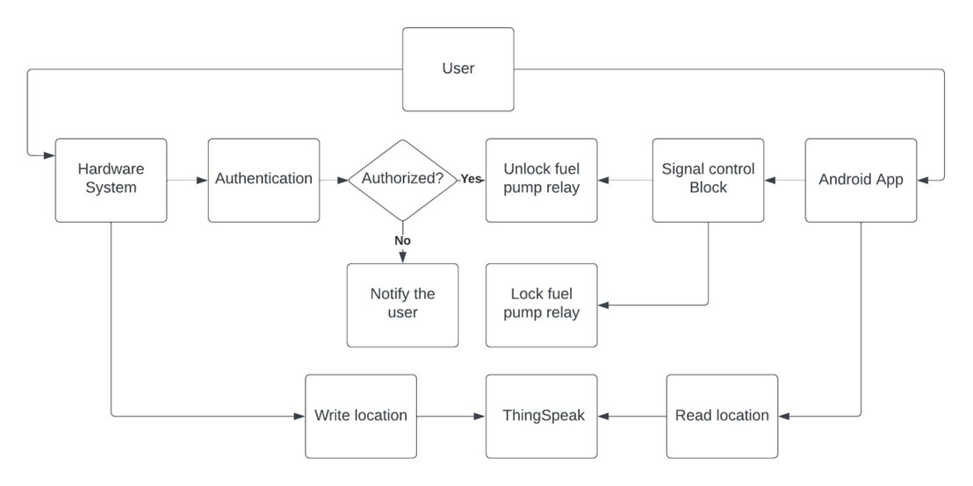
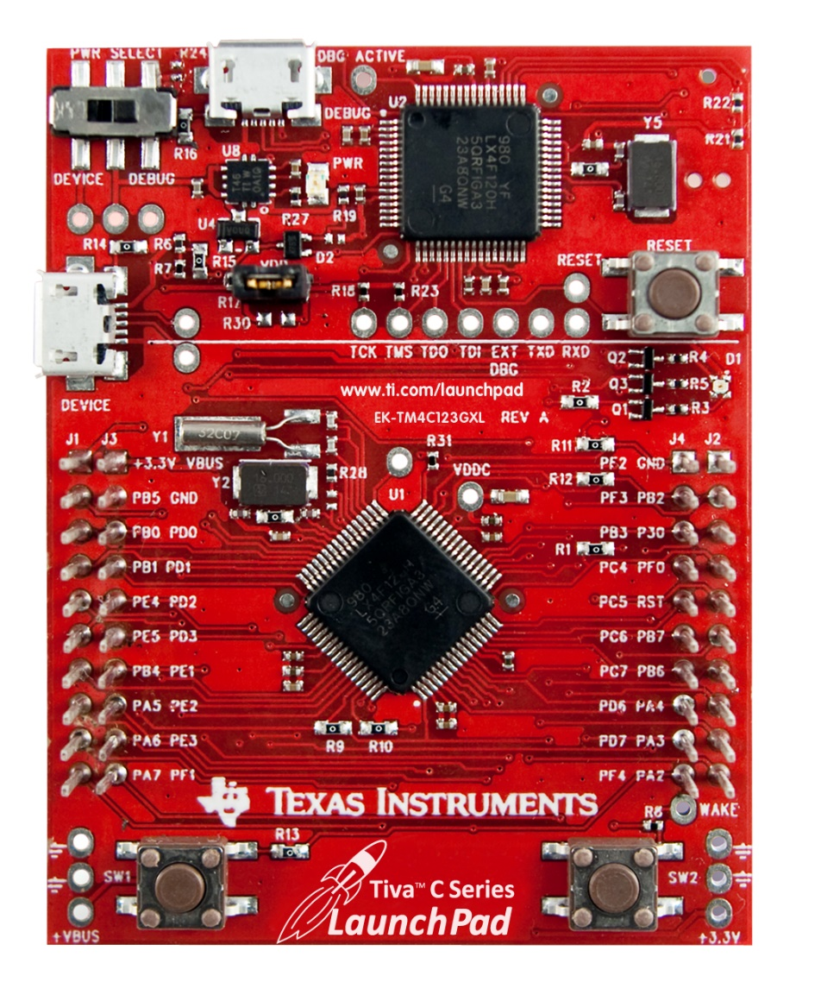
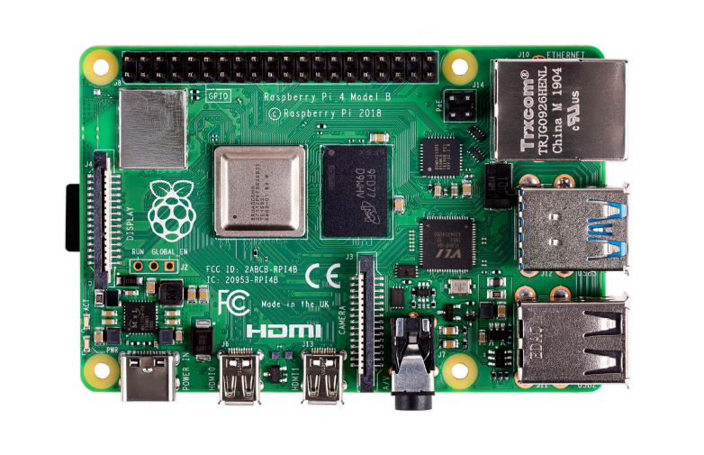
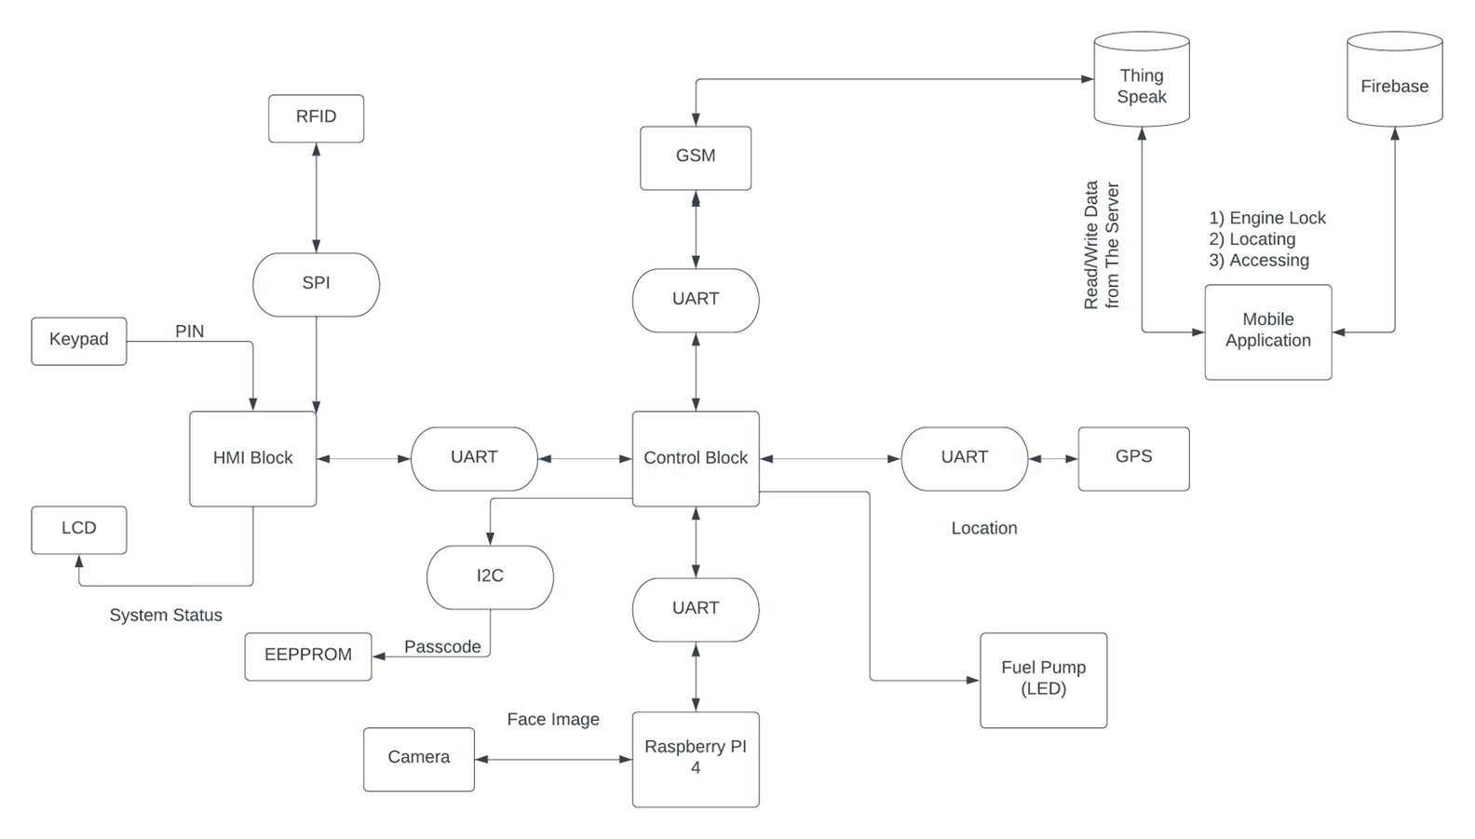
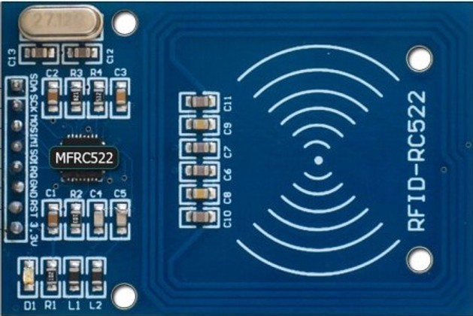
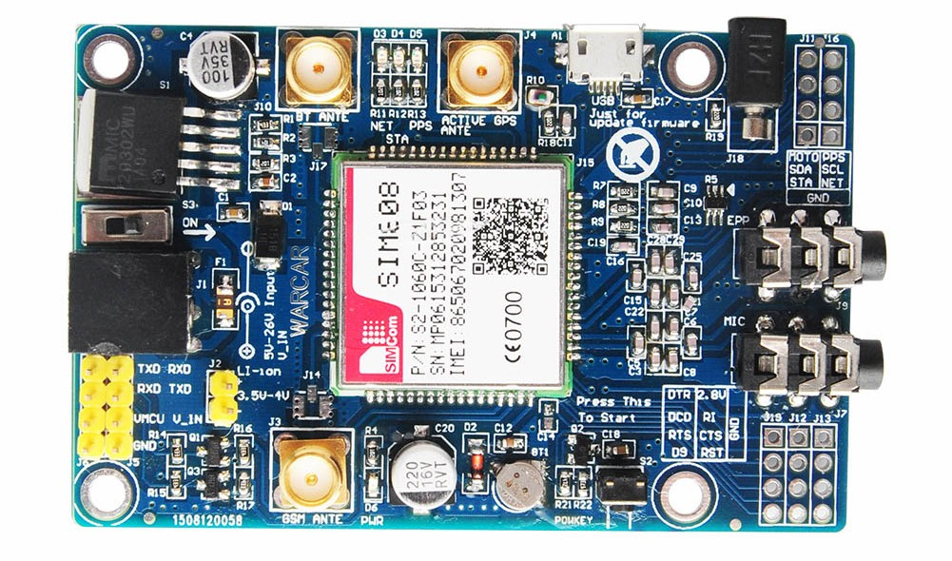
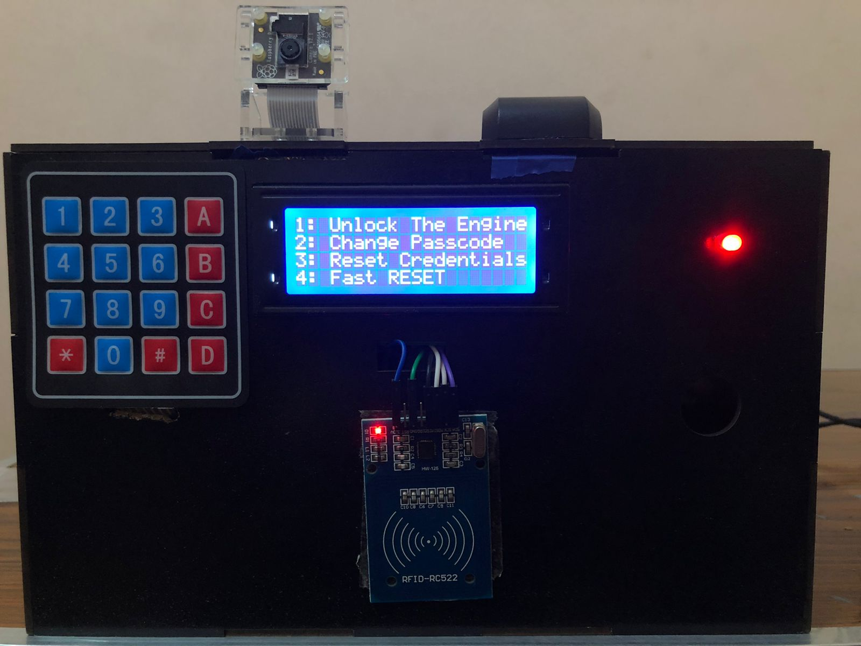
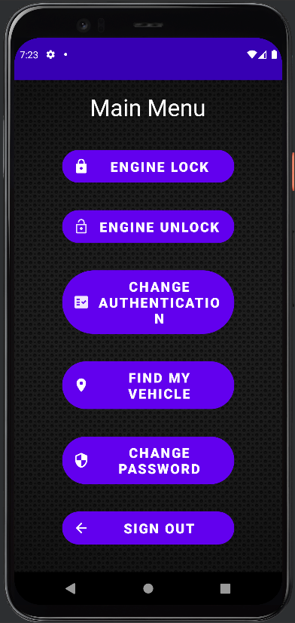
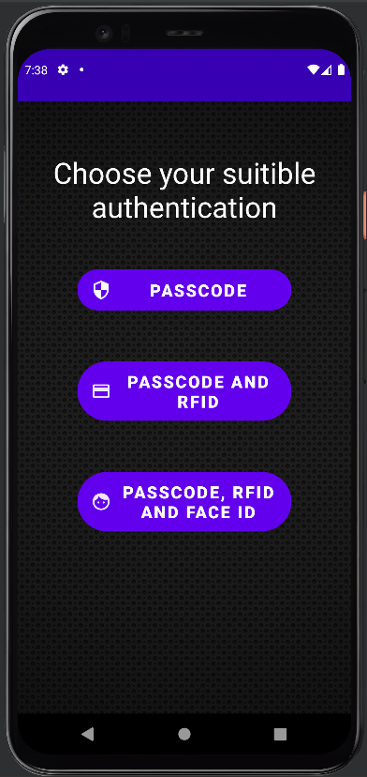
Anti-Theft System for Automobile (2022)
Electrical Engineering Department
Communication and Computer Engineering Program (CCEP)
Introduction
Overview of our System
Results and Discussions
Car Thievery is a Problem That always should be in mind and security measures should be updated from time to time to maintain the vehicle’s safety. There are many people who tried to solve this by applying certain methods and techniques to prevent car thievery by implementing some Security Systems.
We successfully implemented a system that is capable of:
Securing The Vehicle via Passcode using the keypad and the LCD.
Securing the vehicle via RFID Tag using the RFID Module.
Securing The Vehicle via Face ID Using Raspberry PI 4 and Raspberry PI Camera.
Locking The Engine Remotely using Mobile Application.
Unlocking The Engine Remotely using Mobile Application.
Locating The car using Mobile Application.
Problem Statement
Main Block Diagram
Car Thievery is one of the problems that needs addressing worldwide, and one that needs to be solved with technological means. Between 2015 and 2017, 697,000 motor vehicles were stolen in the USA! And about $6 billion were lost to auto theft in 2018, including the theft of cars, trucks, buses, scooters, snowmobiles, and other road vehicles.
Output Prototype
Hardware
Android Application
Conclusion
A combination of 2 Tiva Cs and a Raspberry Pi 4 and other peripherals.
A three-way authentication system that assures no one will access the vehicle but for the authorized users.
The used authentications are
Passcode
RFID
Face ID
After a correct authentication, the Hardware unlocks the fuel pump, and the user can use their vehicle now.
If the user is not authorized the fuel pump remains off, and the hardware notifies the user of an access attempt.
This proves an effective way for the user to communicate with the hardware remotely.
The user can:
Lock The Fuel Pump.
Unlock the Fuel Pump.
Change Authentication Options
Locate Their vehicle.
Change User’s App Password.
After integrating all the parts of software and hardware, we managed to achieve a decent degree of security to ensure that the vehicle will not be stolen.
Using a three-way authentication system ensures only the authorized users will be able to unlock the engine.
The only requirement is that the vehicle has a fuel pump, which is found in all vehicles that runs on fuel.
This targets low end automobiles as well as newer ones.
Motivation
Most of the efforts are exerted on high end vehicles, while most of the car owners own mid to low end automobiles.
We, a group of students, wished to develop a security system that works on most vehicles, targeting mid to low end automobiles.
Scope
Team Members
We are targeting vehicles that may lack any security or Anti-Theft systems with as much low cost as possible, and we are not talking about the need of any manufacturing process we aim to implement this project on an existing car, it’s more like an upgrade and we are not talking about vehicles with specific characteristics or standards, as long the vehicle has a fuel pump! (runs on fuel) the system can be installed on it.
Abdelaziz Abozeid Mohamed
Hazem Youssri Gamal Asqlani
Mourad Eldin Nash’at Mourad Muhammed
Youssef Mamdouh Mohamed El-Nemaky
Used Hardware & Software
Hardware | Software
Tiva C (TM4C123GH6PM) | Eclipse IDE
Raspberry Pi 4 (Model B 8GB RAM) | Visual Studio Code
Raspberry Pi Camera Module 2 Noir | IAR Embedded Workbench
RFID Module (RC522) | Android Studio
GPS/GSM Module (SIM808) | Git
LCD (4X20) | Altium Designer
KEYPAD (4X4)
EEPROM (24C16)
Supervised by
Dr. May Mohamed
Mentored by
Tech Lead Eng. Abdelrahman Mabrouk

